Slide 1
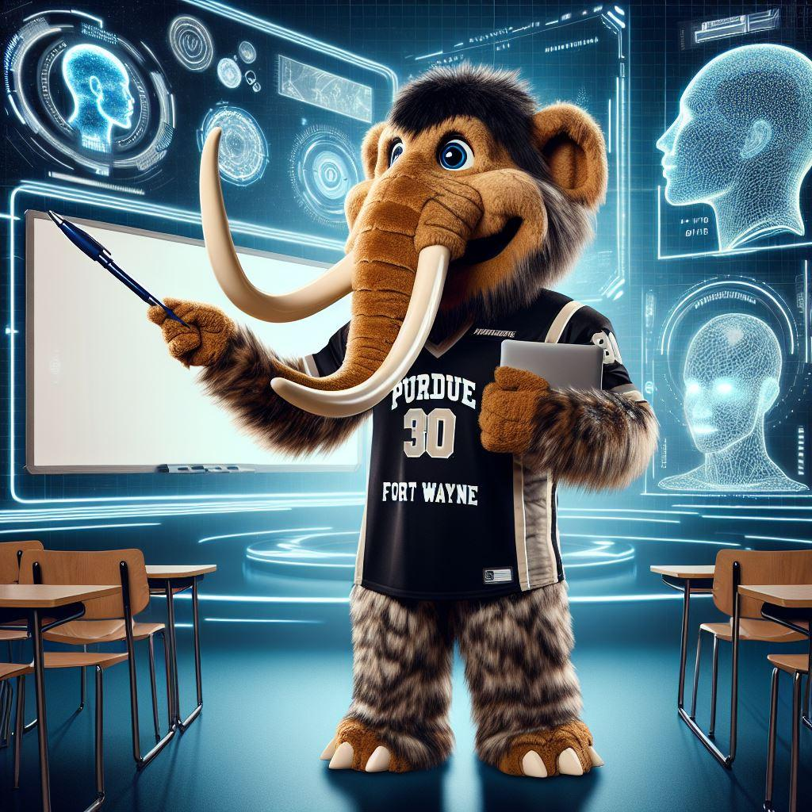
Mastodon TutorAI
Deep Learning Project

Slide 2

TEAM
MEMBERS:
DEEP SHAH
AJINKYA MORE
ALISHA WALUNJ
KANISHK AGARWAL
SHREYAS BEDEKAR
RAHUL BAGUL

Slide 3

MUST HAVE REQUIREMENTS

Slide 4
CONTEXT DRIVEN ANSWERS
PROFESSOR CONTROL
ADMIN INTERFACE

Slide 5
LOW LATENCY
RETRIEVAL AUGMENTED GENERATION
DATA PRIVACY AND SECURITY

Slide 6
NICE TO HAVE REQUIREMENTS

Slide 7
CUSTOMIZED QUIZZES
STUDENT FEEDBACK LOOP
SEARCH HISTORY ACCESS

Slide 8
COURSE PROGRESS TRACKING
TOPIC RECOMMENDER
CACHING FREQUENTLY ASKED QUERIES

Slide 9
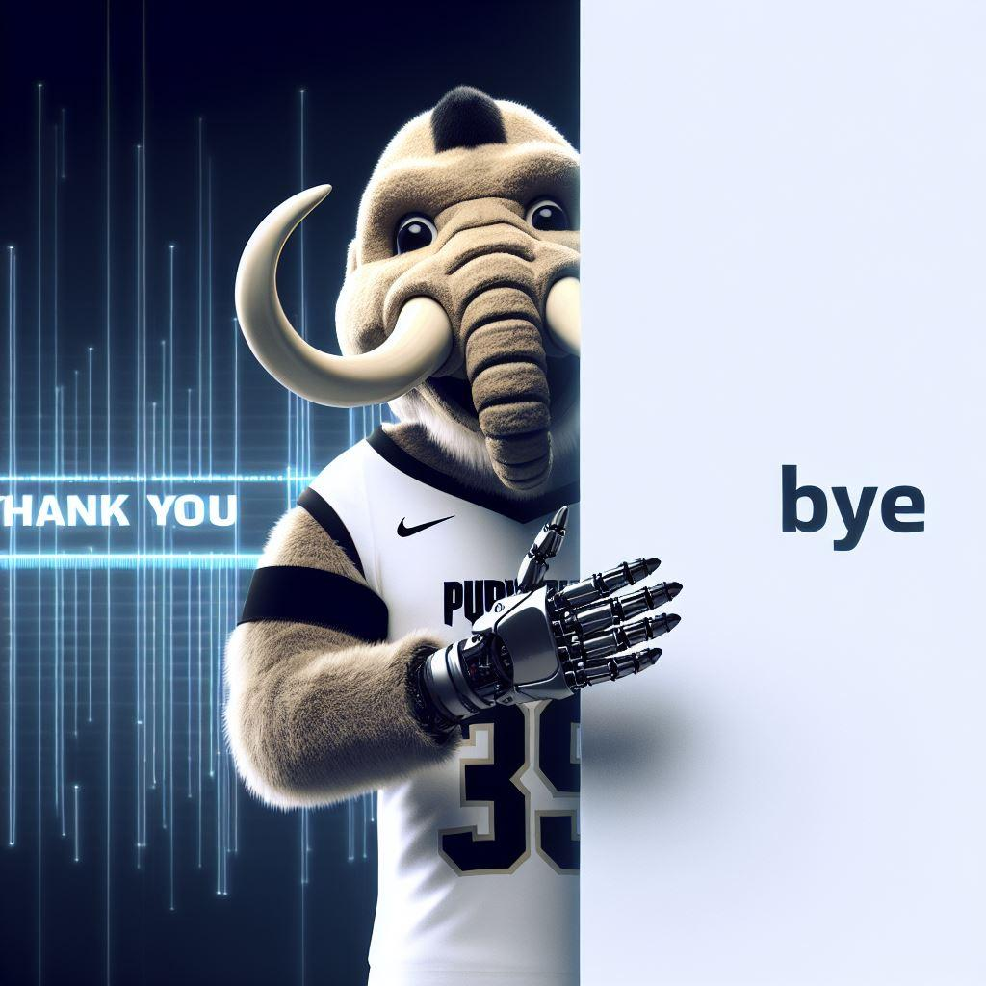
THANK YOU !!

